Slide 1

CSBridge
Notes:
And I will be one of the two lecturers for this course.
A program that teaches high school students like yourselves computer science

Slide 2
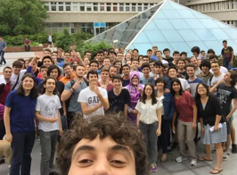
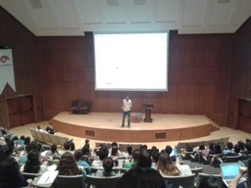
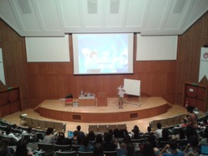
Darüşşafaka Lisesi. 2014
Boğaziçi Ünv. 2015
Koç Ünv. 2016
Koç Ünv. 2017
CTU, Czech Republic +
Koç Ünv. 2018
Notes:
A program that teaches high school students like yourselves computer science
20 students → 100 --> moved to Koc→ 300 in 2 countries!

Slide 3
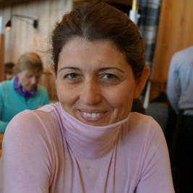

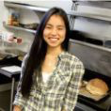
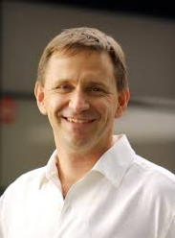
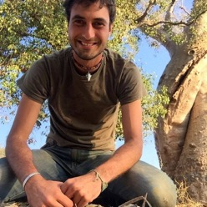
Asena
Bryce
Julia
Nick
Chris
Notes:
a dream of a small group of people
to bridge and connect high school students to computer science, by programming and learning, one step at a time.

Slide 4
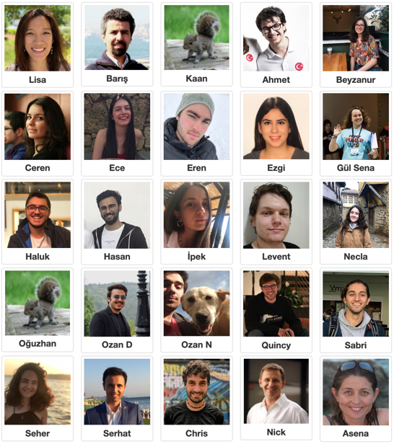
Our awesome 2019 Koç teaching team!
Notes:
I will be leading the morning lectures in English. Baris who is in the second picture at the very top, is going to lead the afternoon lectures in Turkish.
You’ve met your section leaders already, who are all wonderful teachers ready to help you learn CS!
Some of your teachers first started in this program as high school students, and now they came to study Computer Science at Koc and have become Section Leaders . How cool is that? So what you learn in these two weeks can really go a long way.

Slide 5

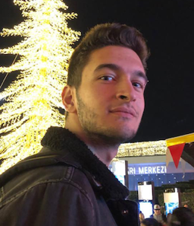
Pelin
Barış
Notes:
VPRD office CS Bridge program managers, who have been arranging your transportation and lodging and emails!

Slide 6
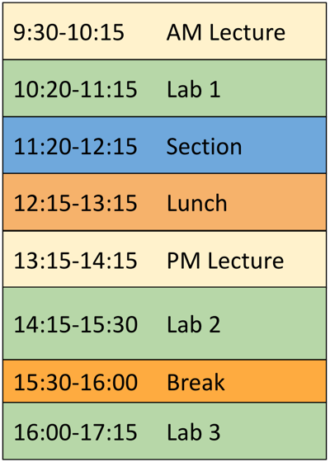
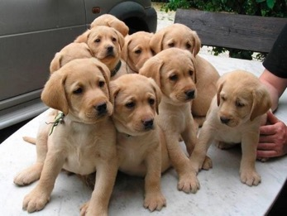



Logistics
LOL: Lots of Labs!
(computer)
Labrador Retrievers (Labs)
Notes:
And now I'm going to show you daily schedule
The whole goal of this program is for you to Learn by doing!!
Schedule is fluid
Explain purpose of lab/section.

Slide 7
Logistics
Discussion Section
Meet your friends and talk through problems with your Section Leader!
Notes:
Schedule is fluid
Explain purpose of lab/section.
Learn by doing!!
leave the lab for a bit,
Step away from the computer and think
blue portion
so that's the daily schedule, which is on your nametag. it will be a bit fluid

Slide 8
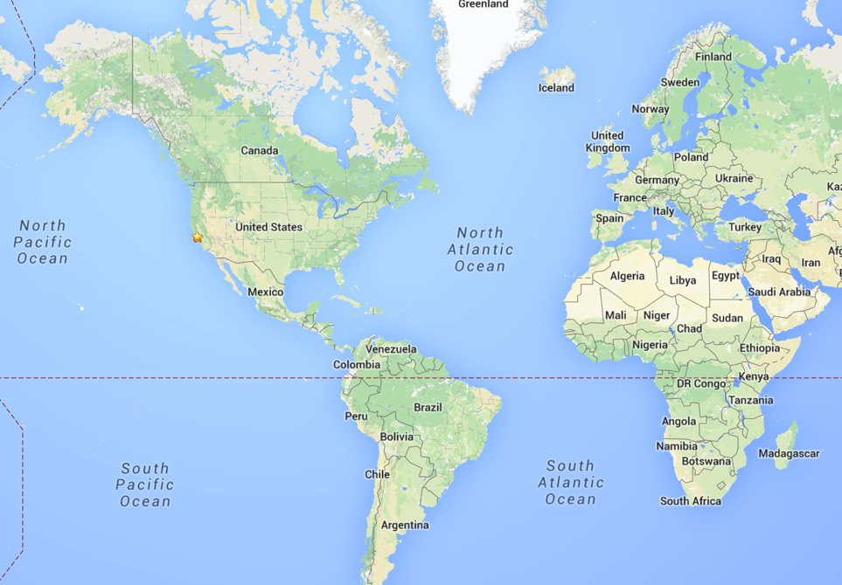
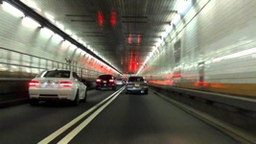
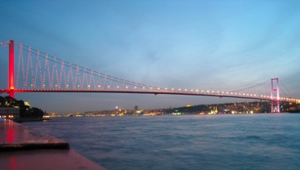
Stanford?
Notes:
Play tennis, like watching all cartoons, and I love learning languages and computer science. I also think Turkish food is the best food in the world.
a wonderful bridge that crosses the Bosphorus river
but back to Stanford.
a lot of my interest in learning and teaching CS

Slide 9
Stanford
Notes:
I currently teach computer science at Stanford.
Did Masters and PhD in Electrical Engineering at Stanford.
I first started computer science in my first year of university.
How much experience did I have when I first did this material? Basically nothing.
It was difficult for me too.
And then I worked on computer science and electrical engineering all through school, until I joined CS Bridge three years ago, when it first came to Koç. And that experience really transformed me, because I saw how much of an impact computer science can have on all of you. And that’s why I’m teaching today.
this course material comes from the introductory CS course at Stanford and Koc. And so it's challenging,
We want all of you to be successful
That’s why we have such a large course staff
to support your own journey in computer science.
Not competing against anyone but yourself. Everyone can win!

Slide 10
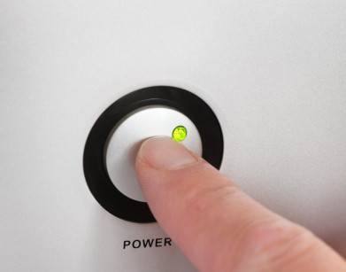
Prerequisites
Notes:
What do you need to know for this class?
Just need to know how to turn on a computer and ask for help.
We love questions!!!

Slide 11
Course Website
http://koc.csbridge.org
*note that its org, not com
Notes:
Link to sign into lab

Slide 12
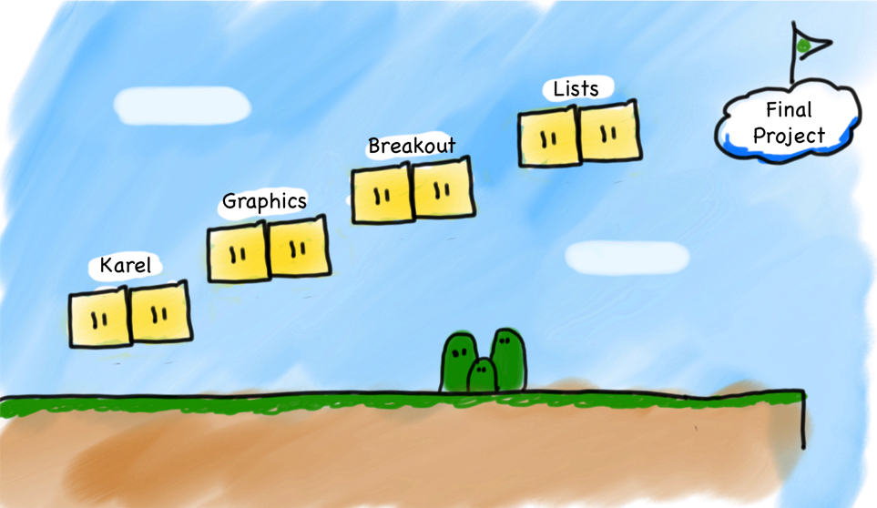
Very High Level Journey
Notes:
hanging out with a cool robot
draw graphics on the screen
program this game called Breakout
work with an important data abstraction called lists
have you create your very own special final project.
We happen to work in Java for this course
we will teach some specific things (Java syntax, Karel commands) but more importantly…
We teach software engineering principles and logic. Much larger than just programming.
Mechanics of the language are nothing compared to the principles.
You are going to learn the principles by programming in Java
(It's not about learning Java)
lots of words on this slide...what do they mean?

Slide 13
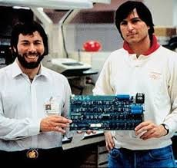
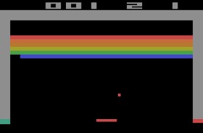
Notes:
Breakout demo!
Atari arcade game 1976 = 43 years ago

Slide 14
Breakout
Notes:
You are going to program this.
But Lisa, I don't even know what it looks like!
demo
start programming it by Friday
so Monday: you turn on the computer, Friday: you program Breakout.

Slide 15
What if I fall behind?
CS Bridge
Notes:
remember that you're not learning alone.
Ask for help. (friends or us) always around to help you
We promise that we will help every one of you to be able to program Breakout by the end of this course.

Slide 16
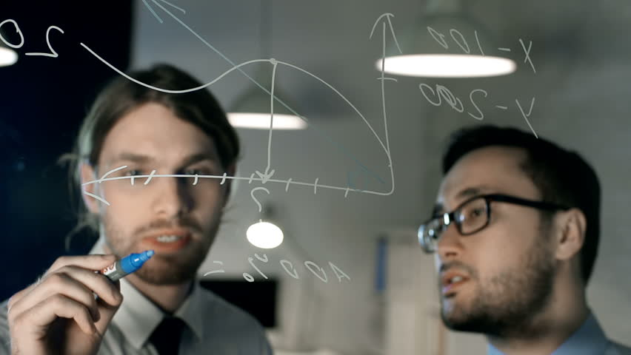
Share Ideas Not Code
Notes:
Goal not to just code Breakout, but to <learn> how to be a computer and software engineer.
There’s no grades
CS Bridge is your own experience, and that means that we want you to learn and get something out of it.

Slide 17
Questions?

Slide 18
Our First Step
Notes:
Let's just jump straight into it!

Slide 19

Karel
Notes:
And now we’re going to jump right into it. We will take our very first step into CS.
Everyone say, “Merhaba Karel!”

Slide 20

Karel Speaks Java
s
Notes:
Karel is a gentle introduction to computer science
because her life is very simple.

Slide 21


Karel’s World
North
3
+
+
+
+
+
2
+
+
+
+
+
West
East
1
+
+
+
+
+
South
1
2
3
4
5

Slide 22

Walls
3
+
+
+
+
2
+
+
+
+
1
+
+
+
+
1
2
3
4

Slide 23

Beepers
3
+
+
+
+
2
+
+
+
+
1
+
+
+
+
1
2
3
4

Slide 24
Knows Four Commands
move();
turnLeft();
pickBeeper();
putBeeper();

Slide 25
move();
Notes:
what do each of these commands do?

Slide 26

move();
3
+
+
+
+
2
+
+
+
+
1
+
+
+
+
1
2
3
4

Slide 27
move();
3
+
+
+
+
2
+
+
+
+
1
+
+
+
+
+
1
2
3
4

Slide 28
turnLeft();

Slide 29
turnLeft();
3
+
+
+
+
2
+
+
+
+
1
+
+
+
+
+
1
2
3
4

Slide 30
turnLeft();
3
+
+
+
+
2
+
+
+
+
1
+
+
+
+
+
1
2
3
4

Slide 31
pickBeeper();

Slide 32
pickBeeper();
3
+
+
+
+
2
+
+
+
+
1
+
+
+
+
+
1
2
3
4
Notes:
karel is on top of the beeper
puts it in her beeper bag

Slide 33
pickBeeper();
3
+
+
+
+
2
+
+
+
+
1
+
+
+
+
+
1
2
3
4

Slide 34
putBeeper();

Slide 35
putBeeper();
3
+
+
+
+
2
+
+
+
+
1
+
+
+
+
+
1
2
3
4

Slide 36
putBeeper();
3
+
+
+
+
2
+
+
+
+
1
+
+
+
+
+
1
2
3
4
Notes:
Today, we're going to navigate Karel through her daily life in her world with just four commands. It’s gonna be great.

Slide 37
Questions?
Notes:
About the program logistics, Karel, about where this program is going?

Slide 38
First Challenge
3
+
+
+
+
2
+
+
+
+
1
+
+
+
+
1
2
3
4
Notes:
As part of playing with Karel,
we want to help Karel navigate her world.

Slide 39
First Challenge
3
+
+
+
+
2
+
+
+
+
1
+
+
+
+
1
2
3
4

Slide 40
First Challenge
move();
pickBeeper();
turnLeft();
putBeeper();
Notes:
I will need a volunteer

Slide 41

Need a Volunteer
Notes:
I'm gonna be Karel, and this is my beeper.

Slide 42
First Challenge
move();
pickBeeper();
turnLeft();
putBeeper();

Slide 43

Let’s Try It
StepUp.java

Slide 44
Questions?

Slide 45
Improving our Program
import stanford.karel.*;
public class StepUp extends Karel {
public void run() {
move();
pickBeeper();
turnLeft();
move();
turnLeft();
turnLeft();
turnLeft();
move();
putBeeper();
move();
}
}
It’s “Turn Right”, but…
🙁 not very clear
😩 tedious
Notes:
We are very happy with our program, but we know that we can always improve. So let’s look at what we can improve.
Not very clear
tedious

Slide 46
Improving our Program
import stanford.karel.*;
public class StepUp extends Karel {
public void run() {
move();
pickBeeper();
turnLeft();
move();
// turns Karel right
turnLeft();
turnLeft();
turnLeft();
move();
putBeeper();
move();
}
}
It’s “Turn Right”, but…
✅ descriptive comments
😩 tedious

Slide 47
Anatomy of a Program
import stanford.karel.*;
public class StepUp extends Karel {
public void run() {
move();
pickBeeper();
turnLeft();
move();
// turns Karel right
turnLeft();
turnLeft();
turnLeft();
move();
putBeeper();
move();
}
}
This is the program's source code
Notes:
Let me give you some definitions of parts of our program, to show you how we can improve it.

Slide 48
Anatomy of a Program
import stanford.karel.*;
public class StepUp extends Karel {
public void run() {
move();
pickBeeper();
turnLeft();
move();
// turns Karel right
turnLeft();
turnLeft();
turnLeft();
move();
putBeeper();
move();
}
}
This piece of the program’s source code is called a method.

Slide 49
Anatomy of a Program
import stanford.karel.*;
public class StepUp extends Karel {
public void run() {
move();
pickBeeper();
turnLeft();
move();
// turns Karel right
turnLeft();
turnLeft();
turnLeft();
move();
putBeeper();
move();
}
}
This word is the name of our method (here, run)
We must always have a run() method to run our program.
But we can make any other methods we want!

Slide 50
Method Definition
private void name() {
statements in the method body
}
This adds a new command to Karel’s vocabulary

Slide 51
Improving our Program
import stanford.karel.*;
public class StepUp extends Karel {
public void run() {
move();
pickBeeper();
turnLeft();
move();
turnRight();
move();
putBeeper();
move();
}
private void turnRight() {
turnLeft();
turnLeft();
turnLeft();
}
}
Call our turnRight method
Define a turnRight method

Slide 52
Anatomy of a Program
import stanford.karel.*;
public class StepUp extends Karel {
public void run() {
move();
pickBeeper();
turnLeft();
move();
turnRight();
move();
putBeeper();
move();
}
private void turnRight() {
turnLeft();
turnLeft();
turnLeft();
}
}
This is called an import statement. It tells Java what Karel is.
Notes:
All these semicolons

Slide 53
Anatomy of a Program
import stanford.karel.*;
public class StepUp extends Karel {
public void run() {
move();
pickBeeper();
turnLeft();
move();
turnRight();
move();
putBeeper();
move();
}
private void turnRight() {
turnLeft();
turnLeft();
turnLeft();
}
}
This is called a code block.
Notes:
Which separates logical parts of your code.

Slide 54
Program Style
import stanford.karel.*;
public class StepUp extends Karel {
public void run() {
move();
pickBeeper();
turnLeft();
move();
turnRight();
move();
putBeeper();
move();
}
private void turnRight() {
turnLeft();
turnLeft();
turnLeft();
}
}
These are terrifying!
Notes:
That's technically correct, but a little difficult to look at.
because I'm not sure where code blocks, those logical segments of my program, start and end.
And so what I’m going to talk about next won’t help your program run better, but it will help you think better. And it’s always good to organize your thoughts on paper, so this is organizing your code on the computer.
And this is called good *style* when programming.

Slide 55
Program Style
import stanford.karel.*;
public class StepUp extends Karel {
public void run() {
move();
pickBeeper();
turnLeft();
move();
turnRight();
move();
putBeeper();
move();
}
private void turnRight() {
turnLeft();
turnLeft();
turnLeft();
}
}
Style Tip #1:
Align braces in your code blocks.
Notes:
Talk about indentation

Slide 56
Program Style
import stanford.karel.*;
public class StepUp extends Karel {
public void run() {
move();
pickBeeper();
turnLeft();
move();
turnRight();
move();
putBeeper();
move();
}
private void turnRight() {
turnLeft();
turnLeft();
turnLeft();
}
}
Style Tip #1:
Align braces in your code blocks.
Notes:
Talk about indentation

Slide 57
Program Style
import stanford.karel.*;
public class StepUp extends Karel {
public void run() {
move();
pickBeeper();
turnLeft();
move();
turnRight();
move();
putBeeper();
move();
}
private void turnRight() {
turnLeft();
turnLeft();
turnLeft();
}
}
Style Tip #1:
Align braces in your code blocks.
Notes:
Talk about indentation

Slide 58
Program Style
import stanford.karel.*;
public class StepUp extends Karel {
public void run() {
move();
pickBeeper();
turnLeft();
move();
turnRight();
move();
putBeeper();
move();
}
private void turnRight() {
turnLeft();
turnLeft();
turnLeft();
}
}
Style Tip #2:
Align indentation in your code blocks.
Notes:
Talk about indentation

Slide 59
Program Style
import stanford.karel.*;
public class StepUp extends Karel {
public void run() {
move();
pickBeeper();
turnLeft();
move();
turnRight();
move();
putBeeper();
move();
}
private void turnRight() {
turnLeft();
turnLeft();
turnLeft();
}
}
Style Tip #2:
Align indentation in your code blocks.
Notes:
Talk about indentation

Slide 60
Questions?
Notes:
About the program logistics, Karel, about where this program is going?

Slide 61
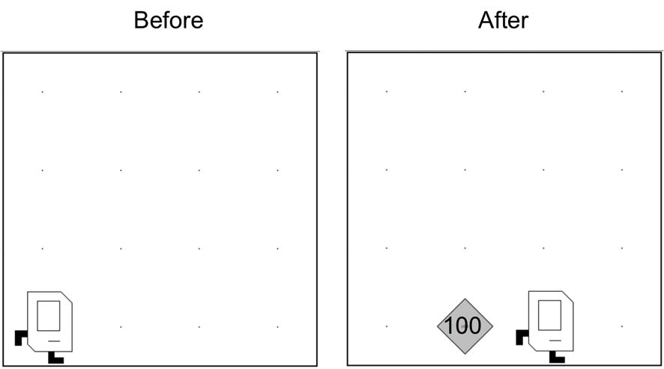
Place 100 beeper?
Place100.java
Notes:
Do I have the solution for you. Beautiful style
And this program works, but there must be a better way!

Slide 62
For Loop
for(int i = 0; i < N; i++) {
// to repeat N times
}
Notes:
anything inside this code block, that means inside these braces,
I will repeat N times. where N is a number I specify.

Slide 63
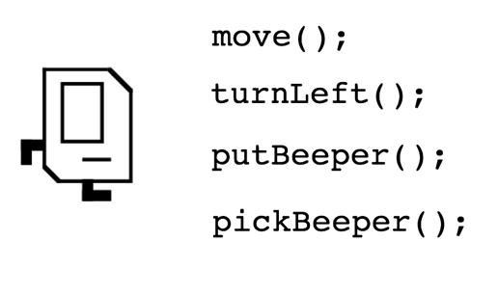
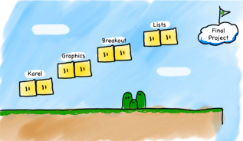
Review
Helper methods for defining new commands
private void name() {
statements in the method body
}
for loops repeat code N times
N
for(int i = 0; i < N; i++) {
// to repeat N times
}
Notes:
Defining new commands to keep our code clean, that was us defining turnRight() and being able to use that instead of three turnLefts
Repeat something exactly N times.

Slide 64
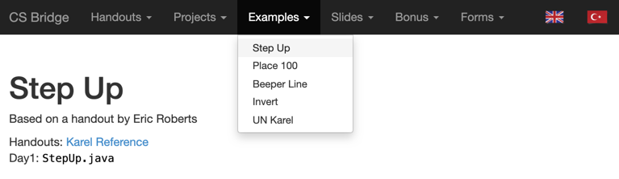
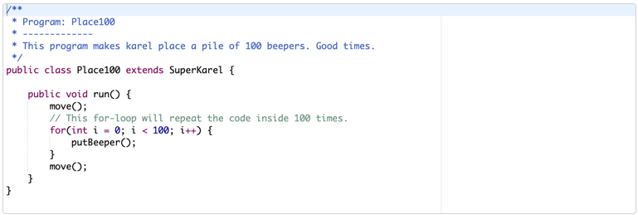
Today’s Examples on the Website

Slide 65
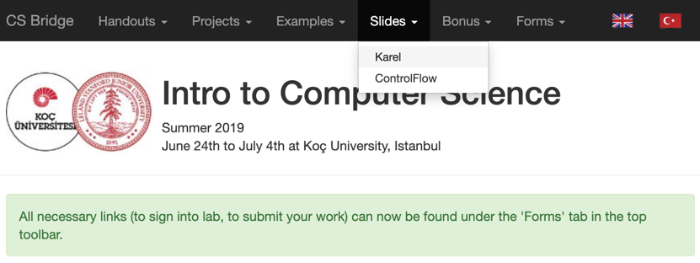
Today’s Slides on the Website

Slide 66
Your turn
x 200
(in Labs)
Notes:
It's your turn to become wizards!

Slide 67
Newspaper Karel

Slide 68
Build Efes
Notes:
Build the ancient city of Efes, by building columns of beepers.
(Temple of Artemis), Izmir

Slide 69
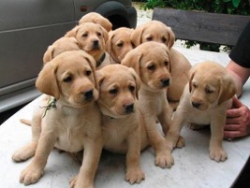
Your turn
To the Labs!!

Slide 70
What if I fall behind?
Different learning curves
My friend who had programmed before
Knowledge
Lisa (me)
Time
Notes:
First, it is okay! Everyone learns at a different pace.
Ask for help.

